Slide 1
Clojure with a J
Bruno Kim Medeiros Cesar

Slide 2

What is Clojure?
Dynamically typed
Lisp syntax
Hosted (JVM, JS, CLR)
Functional (but not pure)
Immutable data structures
Concurrency primitives

Slide 3

Syntax

Slide 4
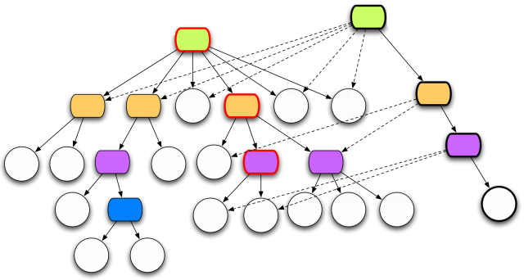

Slide 5
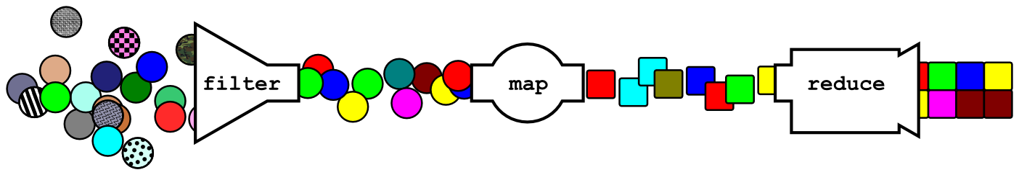
Functional idioms

Slide 6

JVM integration

Slide 7
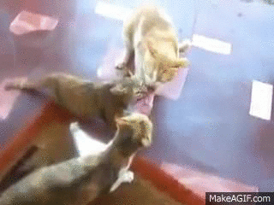
Concurrency

Slide 8
Why Clojure? A personal view
Pragmatic and functional
Direct access to host features
Macros macros macros macros macros m
It's just a library
Great community

Slide 9
Obrigado!

Slide 10
Media attribution
Clojure logo by Tom Hickey;
Sun eclipse photo by Ben Brockert;
Immutable vector structure by Rich Hickey;
The Java logo is a trademark of Oracle Inc;
3 cats, 1 steak: http://youtu.be/PMD5FS20tTY
This presentation is distributed under the Creative Commons Attribution-ShareAlike 3.0 (CC BY-SA) License

